Slide 1

Applied Machine (and Statistical) Learning in Python for Economics and Econometrics
Larry

Slide 2
Our Website
https://github.com/dustoff06/EcoMod/

Slide 3
Why Machine Learning?
Handling large (HUGE) datasets
Improving predictive accuracy
Causal inference
Policy analysis and simulation
Enhancing productivity
Adapting to industry trends
Academic and professional competitiveness
Interdisciplinary research

Slide 4
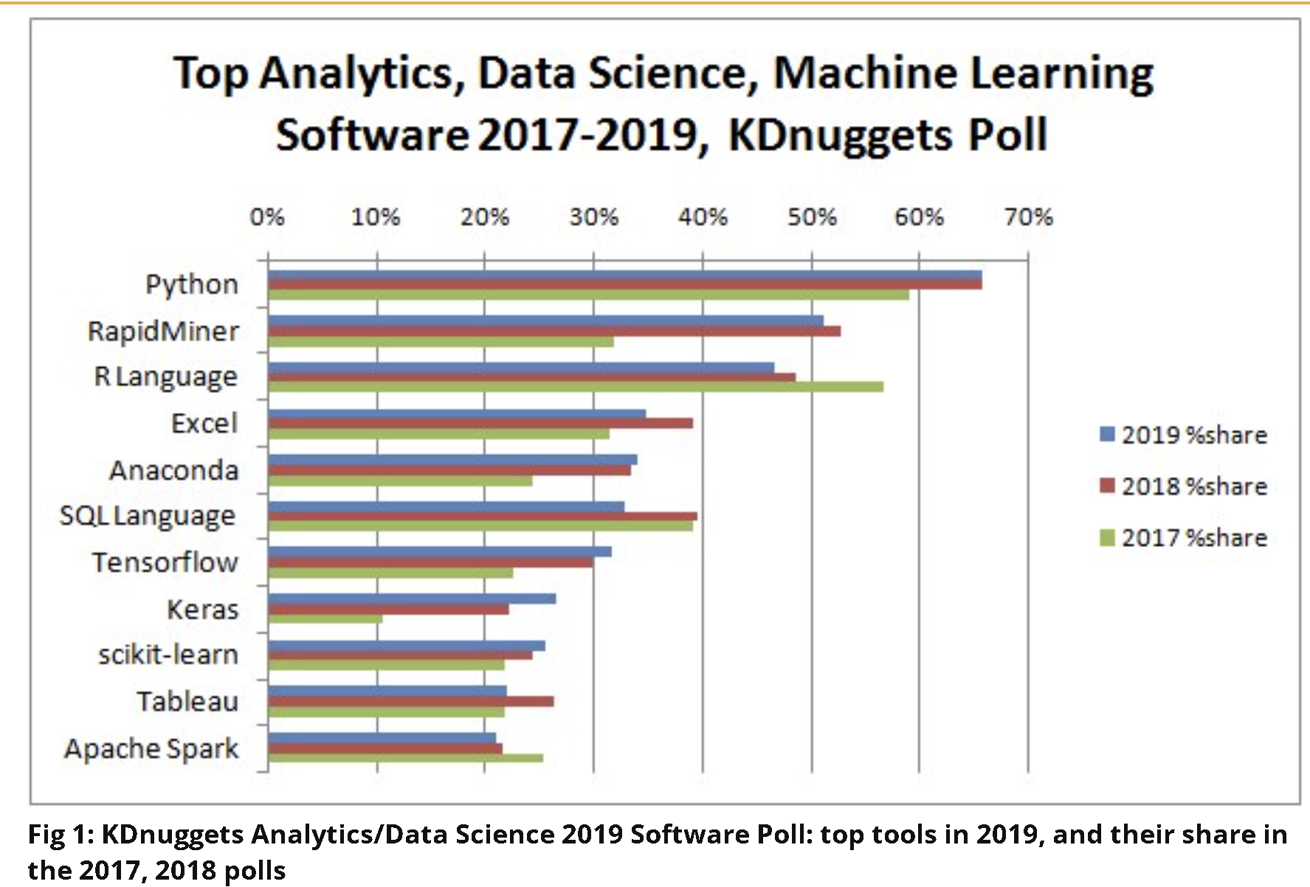
Why Python?
Comprehensive libraries and frameworks
Ease of use and readability
Strong community and support
Versatility and flexibility
Integration with other tools, languages, and platforms
Data handling (LARGE) and visualization
Industry adoption and ecosystem

Slide 5

What is Statistical Learning?
Finding the function that best fits the data-Rooted in Statistics
y=f(X)+e
A typical regression model would assume that f is a linear function and that each e_{i} is independent and identically distributed as normal centered at zero with constant variance (homoscedastic).
In statistical learning, we want to estimate f.
Estimating f is useful for both inference and prediction.
Statistical learning is interpretable

Slide 6
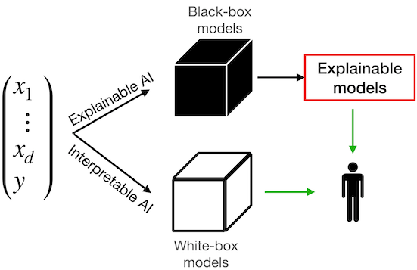
What is Machine Learning?
Finding methods, often black box, that predict well-rooted in Computer Science
Focuses on prediction accuracy and the ability to generalize well to new, unseen data. The goal is often to develop models that perform well on a specific task, sometimes at the expense of interpretability. Models may be explainable but not interpretable. In practice, SL & ML overlap more and more.

Slide 7
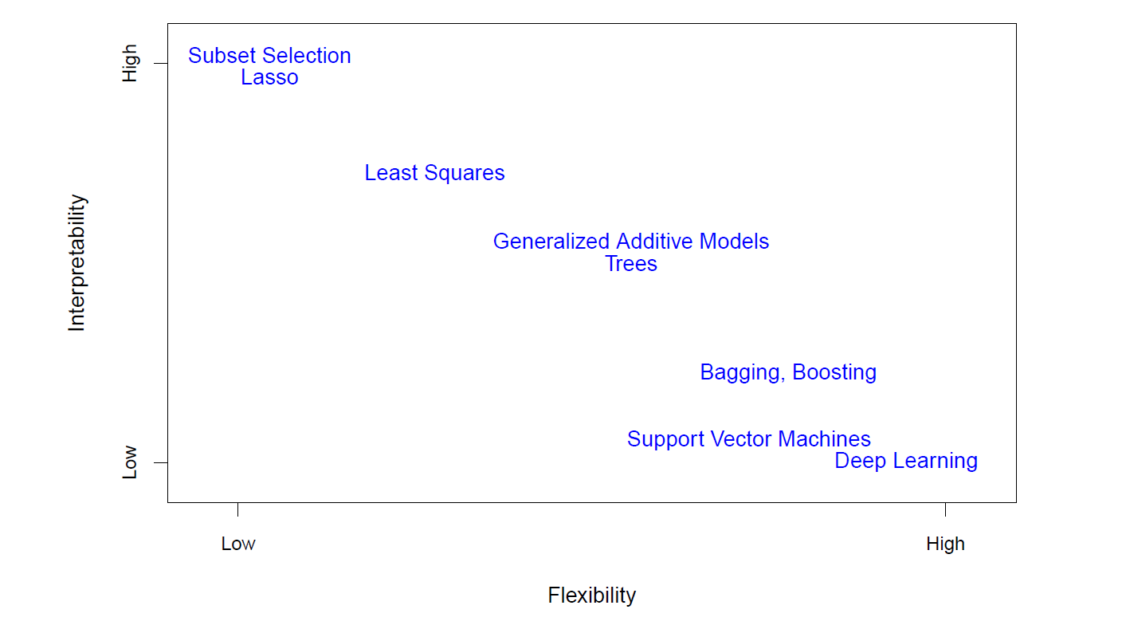
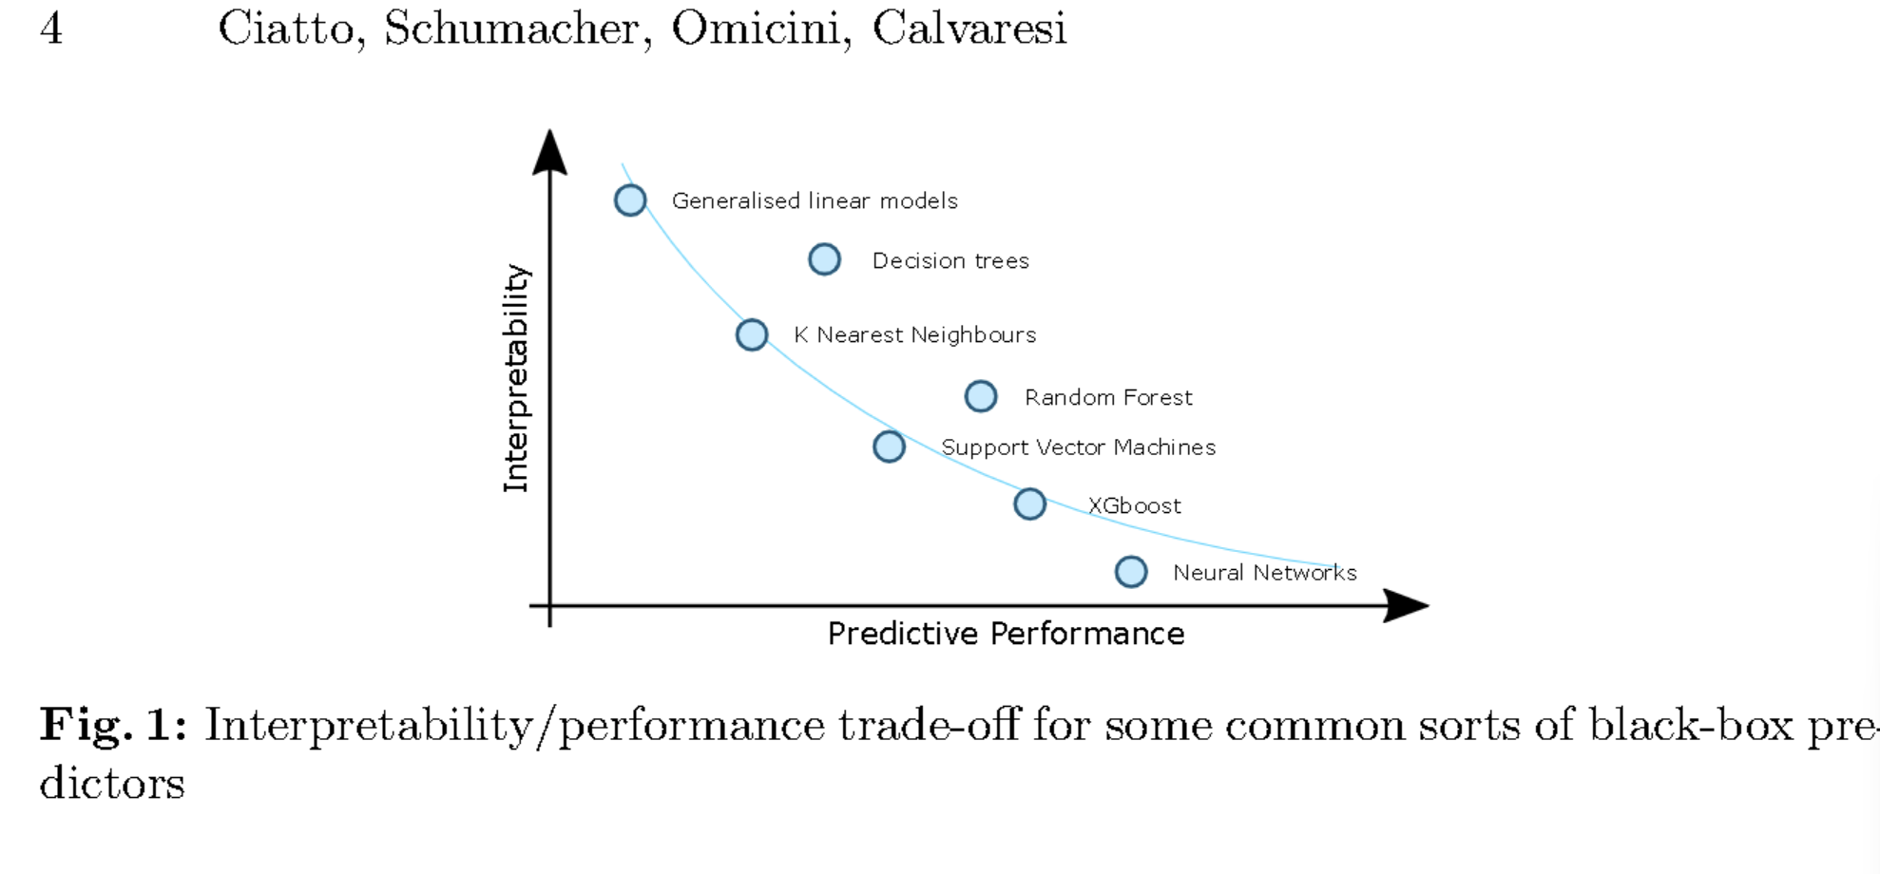
Interpretability versus Flexibility

Slide 8
Model Types & Purposes
Types (Generic)
Purposes
Supervised
Semi-supervised
Unsupervised
Classification
Regression
Similarity / Clustering
Segmentation (Images)
Text Analysis
Many others

Slide 9
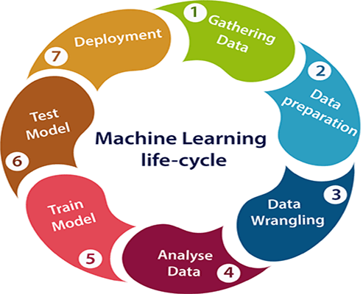
The Machine Learning LIfecycle

Slide 10

Gathering Data, Preparing it, and Beating it into Submission
80-90% of the time spent is on EDA
Missing analysis / handling by row / column
Distribution checking
Relationship evaluation
Feature engineering
Perhaps, text or image preprocessing
End State: Data ready for use in modeling

Slide 11

Data Preparation
Cleaning: Remove or correct any inaccuracies, inconsistencies, or missing values in the dataset.
Normalization/Standardization: Scale features to ensure they contribute equally to the model's performance.
Feature Engineering: Create new features from existing data to improve model performance.
Feature Selection: Select the most relevant features to reduce dimensionality and avoid overfitting.

Slide 12
Training / Validation / Test Split
Train-Test Split: Divide the dataset into training and testing sets to evaluate the model’s performance.
Train-Validation Split: Further divide the data into two groups for hyperparameter tuning
Cross-Validation: Use techniques like k-fold cross-validation to assess the model’s ability to generalize to new data on the training

Slide 13

Model Selection
Algorithm Choice: Choose appropriate algorithms based on the problem type (e.g., regression, classification, clustering).
Baseline Models: Start with simple models as a baseline before moving to more complex models.

Slide 14

Hyperparameter Tuning
Grid Search: Exhaustively search over a specified parameter grid.
Random Search: Randomly sample parameter settings.
Bayesian Optimization: Use probabilistic models to find the optimal hyperparameters efficiently.

Slide 15

Overfitting & Underfitting
Regularization: Apply techniques like L1, L2 regularization to penalize large coefficients.
Early Stopping: Stop training when the model performance on the validation set starts to degrade.
Cross-Validation: Use cross-validation to detect and mitigate overfitting.

Slide 16

Model Evaluation
Metrics: Use appropriate metrics such as accuracy, precision, recall, F1 score for classification, and RMSE, MAE for regression.
Confusion Matrix: Evaluate the performance of classification models.
ROC-AUC: Assess the performance of binary classifiers.

Slide 17
Model Interpretability
Feature Importance: Determine which features contribute most to the model’s predictions.
Partial Dependence Plots: Visualize the relationship between features and predicted outcomes.
SHAP Values: Use SHAP (SHapley Additive exPlanations) values for model interpretability.

Slide 18

Scalability and Efficiency
Algorithm Efficiency: Choose algorithms that can handle large datasets efficiently.
Parallel Processing: Use parallel processing to speed up training.
Hardware Acceleration: Leverage GPUs or TPUs for training complex models, especially deep learning models.

Slide 19

Deployment Considerations
Model Serialization: Save the trained model for deployment.
Inference Time: Ensure the model can make predictions in a reasonable time.
Scalability: Ensure the deployment environment can scale with the demand.

Slide 20

Continuous Monitoring and Maintenance
Performance Monitoring: Continuously monitor the model’s performance in production.
Retraining: Retrain the model periodically with new data to maintain its accuracy.
Concept Drift: Detect and address any changes in the underlying data distribution over time.

Slide 21

Review / Introduction to Python using Google Colab

Slide 22
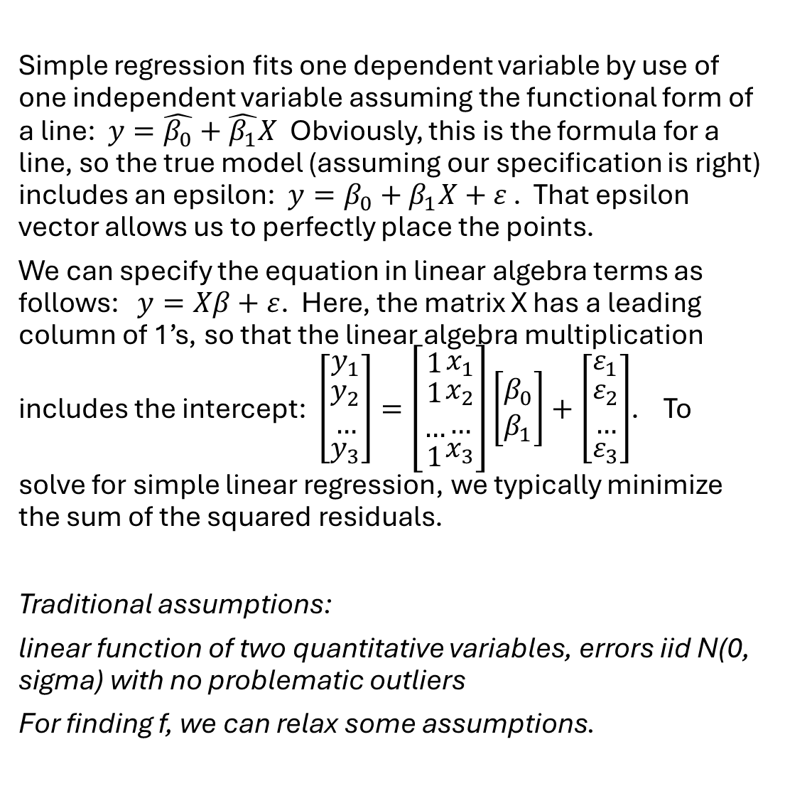
A Quick Review of Regression
Simple regression fits one dependent variable by use of one independent variable assuming the functional form of a line: $y=\hat{β_{0}}+\hat{β_{1}}X$ Obviously, this is the formula for a line, so the true model (assuming our specification is right) includes an epsilon: $y=β_{0}+β_{1}X+ε$ . That epsilon vector allows us to perfectly place the points.
We can specify the equation in linear algebra terms as follows: $y=Xβ+ε$. Here, the matrix X has a leading column of 1’s, so that the linear algebra multiplication includes the intercept: $\left[\begin{matrix}y_{1} \\ \begin{matrix}y_{2} \\ …\end{matrix} \\ y_{3}\end{matrix}\right]=\left[\begin{matrix}1 \\ \begin{matrix}1 \\ …\end{matrix} \\ 1\end{matrix}\begin{matrix}x_{1} \\ \begin{matrix}x_{2} \\ …\end{matrix} \\ x_{3}\end{matrix}\right]\left[\begin{matrix}β_{0} \\ β_{1}\end{matrix}\right]+\left[\begin{matrix}ε_{1} \\ \begin{matrix}ε_{2} \\ …\end{matrix} \\ ε_{3}\end{matrix}\right]$. To solve for simple linear regression, we typically minimize the sum of the squared residuals.
Traditional assumptions:
linear function of two quantitative variables, errors iid N(0, sigma) with no problematic outliers
For finding f, we can relax some assumptions.

Slide 23

Testing Regression Assumptions
Linearity: Check residual vs. fitted plots and scatter plots.
1
Independence: Use Durbin-Watson test.
2
Homoscedasticity: Check residual plots and use Breusch-Pagan test.
3
Normality: Use Q-Q plots, histograms, and Shapiro-Wilk test
4
Multicollinearity: Use VIF and correlation matrix.
5

Slide 24
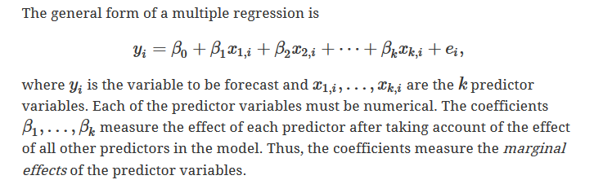
Multiple Regression

Slide 25
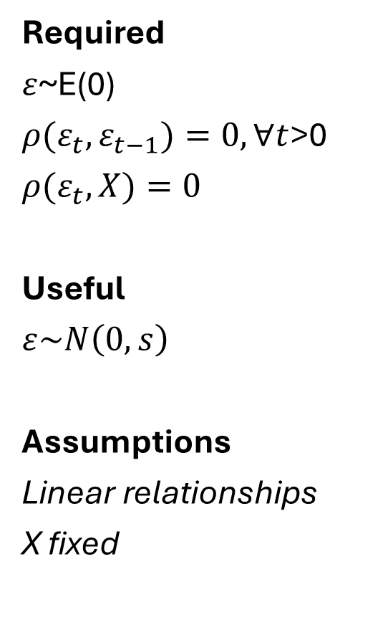
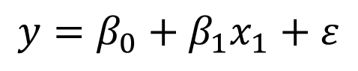
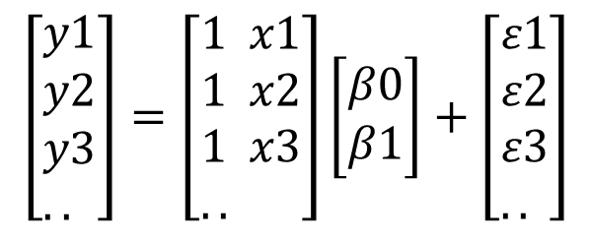
Simplified Regression Assumptions for Prediction
Required
$ε$~E(0)
${ρ(ε}_{t},ε_{t−1})=0, ∀t$>0
$${ρ(ε}_{t},X)=0$$
Useful
$$ε\sim N\left(0,s\right)$$
Assumptions
Linear relationships
X fixed
$$y=β_{0}+β_{1}x_{1}+ε$$
$$\left[\begin{aligned}&y1 \\ &y2 \\ &y3 \\ &..\end{aligned}\right]=\left[\begin{aligned}&1 x1 \\ &1 x2 \\ &1 x3 \\ &..\end{aligned}\right]\left[\begin{aligned}&β0 \\ &β1\end{aligned}\right]+\left[\begin{aligned}&ε1 \\ &ε2 \\ &ε3 \\ &..\end{aligned}\right]$$

Slide 26
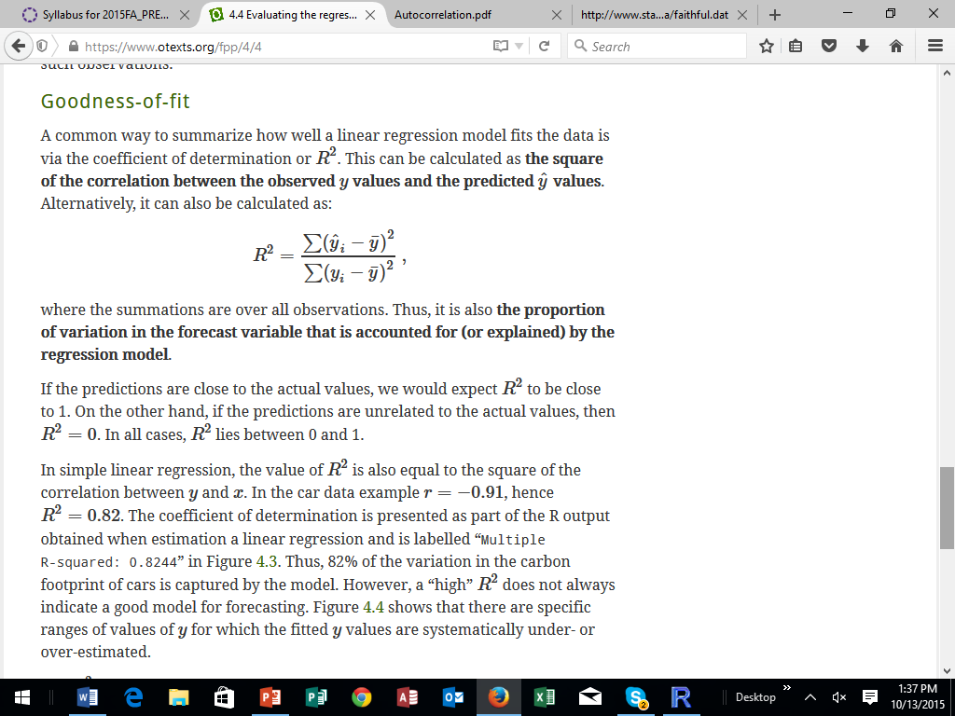
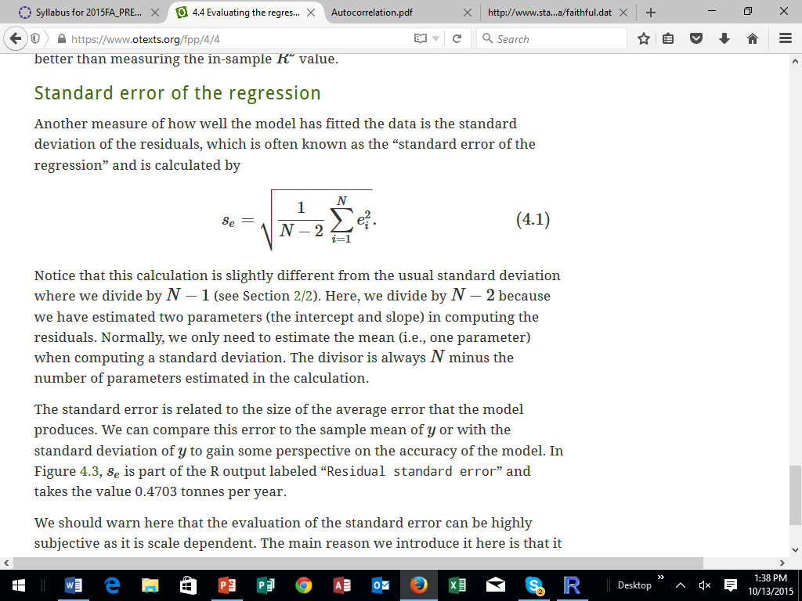
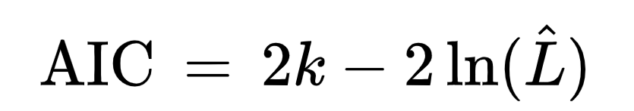
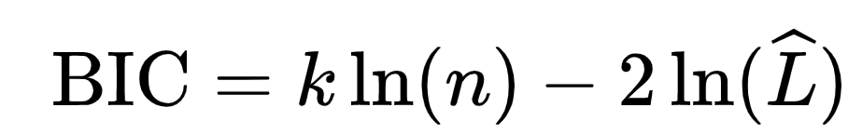
Common Measures of Fit for Regression

Slide 27

AIC versus BIC, 2p vs. pln(N)
BIC and AIC are similar
Different penalty for number of parameters
The BIC penalizes free parameters more strongly than does the AIC.
Implications: BIC tends to choose smaller models
The larger the N, the more likely that AIC and BIC will disagree on model selection

Slide 28

With Dichotomous Variables, Polynomial Terms, Interactions, and Box-Cox Transformations

Slide 29
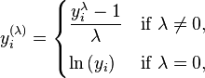
Box-Cox Transformations
How do you attempt to normalize all variables to achieve MVN? Box-Cox helps…
Minimize the difference between normality (pick a test) and actual data by manipulating lambda

Slide 30

Applied Exercises 8, 9, and 10 for Chapter 2

